Slide 1

St Lawrence Hub
Reading in FS/KS1
The need to read!
Wednesday 12 February 2025
Communication skills
Wide vocabulary
Fuels imagination and creativity
Critical thinking
Reduced stress
General knowledge

Slide 2




When and where?
Everyday!
Little and often
A time that suits you and your child…no stress!
Reluctant readers….
Bed
Breakfast table
On the stairs
Behind the sofa
In the park
On the train
In a waiting room
Reading can happen anywhere!

Slide 3
What?
Decodable readers
Any and all other books!
E-books (Free downloadable Sounds-Write e-books at
https://sounds-write.co.uk/support-for-parents-and-carers/ )
Comics
Non-fiction
Labels
Signs
Lists
Letters and cards etc. etc.

Slide 4
How?
Sounds-Write-friendly phrases:
Say the sounds and read the word.
This is the way we spell the sound … in x (e.g. ie in pie).
Same spelling, different sound (rough, thought, dough, bough, cough).
Same sound, different spelling (play, pain, gate, steak, eight, they, reign).
This is the word x (e.g. was).
Two/three/four letters, one sound. A two/three/four letter spelling
Shared and echo reading can really help!
Video on SW website https://sounds-write.co.uk/decodables-help/
and free parent course

Slide 5

How?
https://www.stlawrencehurst.co.uk/English/
Now enjoy reading with your child in their class!

Slide 6
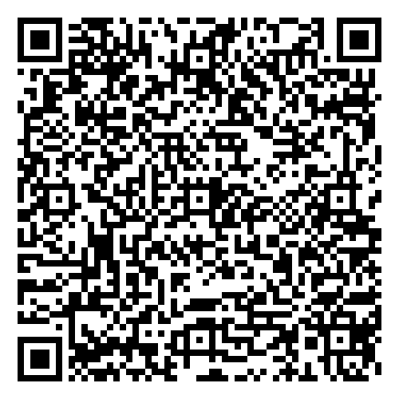

Thank you for attending the month’s Hub.
Please scan the below QR code for feedback.
Please help stack the chairs into stacks of 8
before you leave.
Thank you

